Slide 1
New England Stranding Data Analysis
Josh Meza-Fidalgo, Jess Ozog, Britney Pepper

Slide 2
Data
Collected by Mystic Aquarium
Curated & managed by OBIS-SEA
Cetaceans, pinnipeds, & turtles in NE
Cetaceans divided into Mysticetes and Odontocetes
1990-2011

Slide 3
Question(s)
Are there any significant differences between years and/or months for strandings for each family group?
Are there any temporal trends/patterns?
How are the strandings related geospatially?

Slide 4
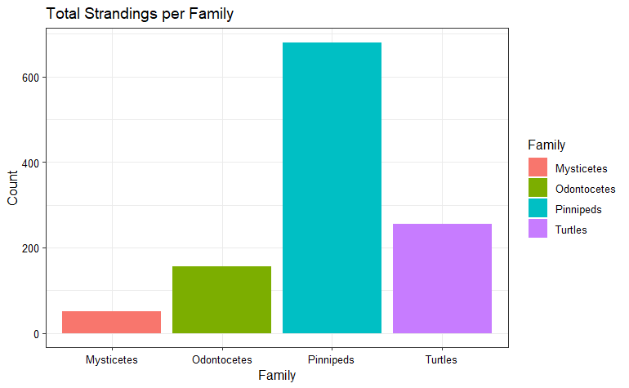
Wrangling and exploration
Divided into 4 families for specific analyses
Pinnipeds
Turtles
Mysticetes
Odontocetes
Further wrangling to determine # of strandings of each family by year and month
Geospatial Wrangling

Slide 5
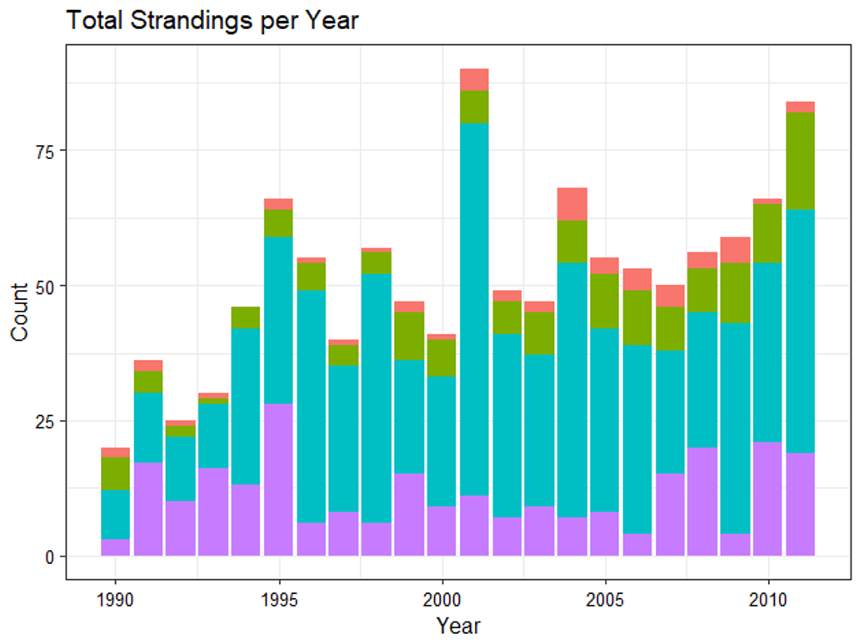
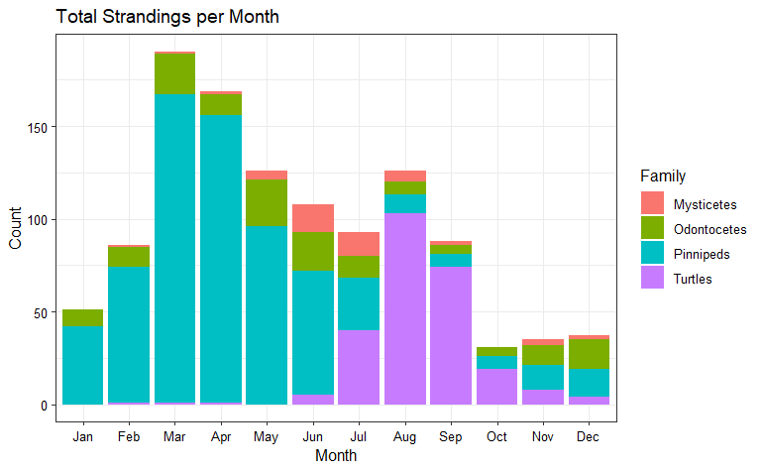

Slide 6
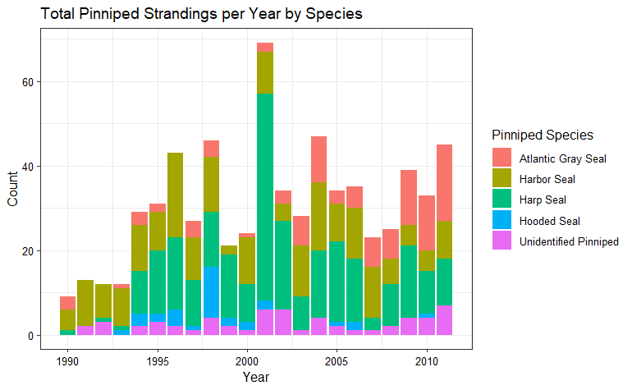
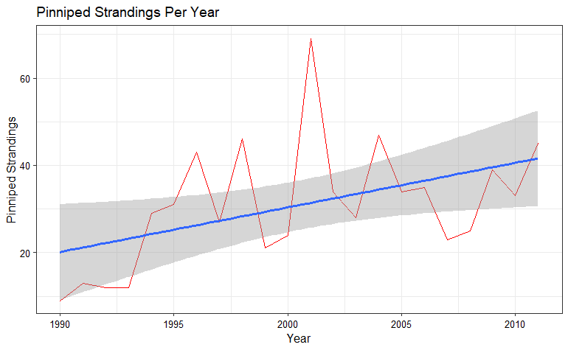
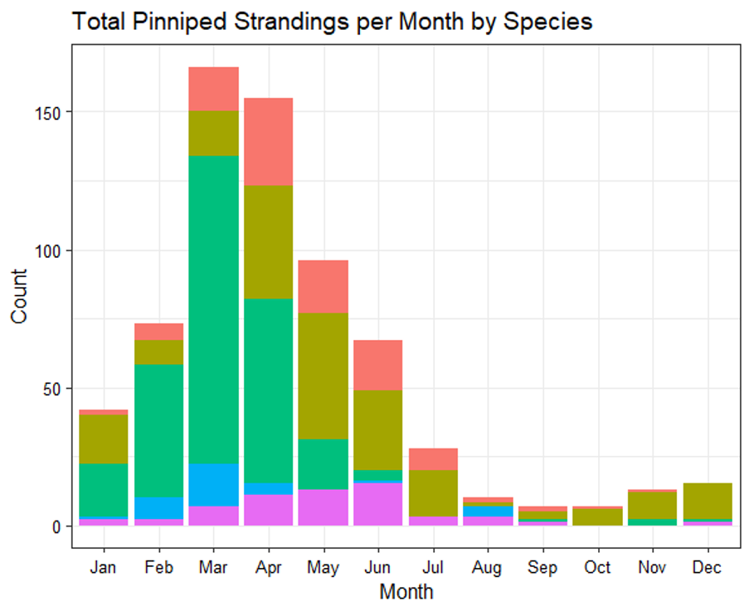

Slide 7
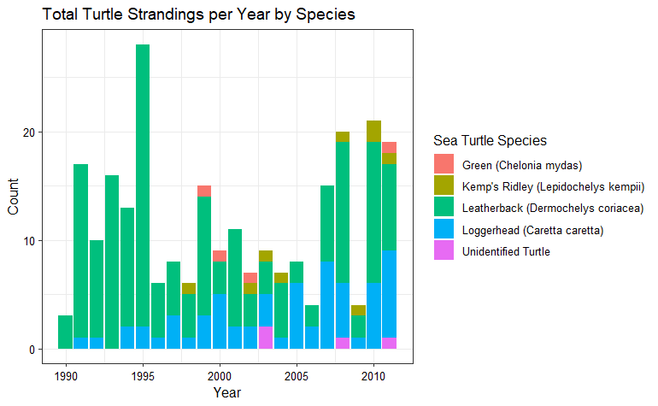

Slide 8
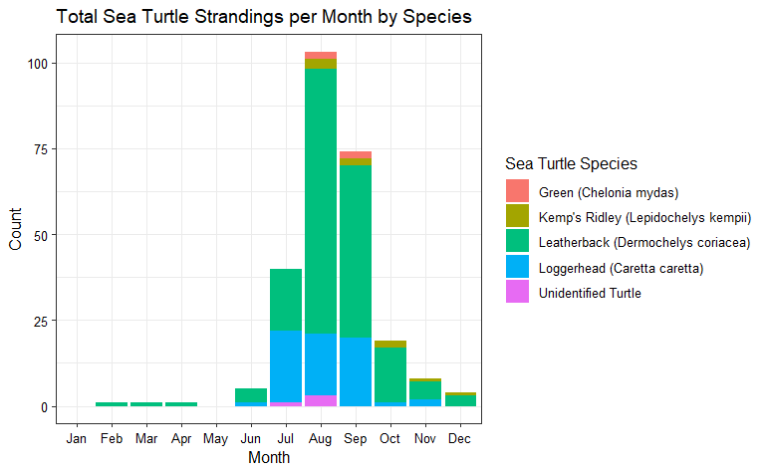

Slide 9
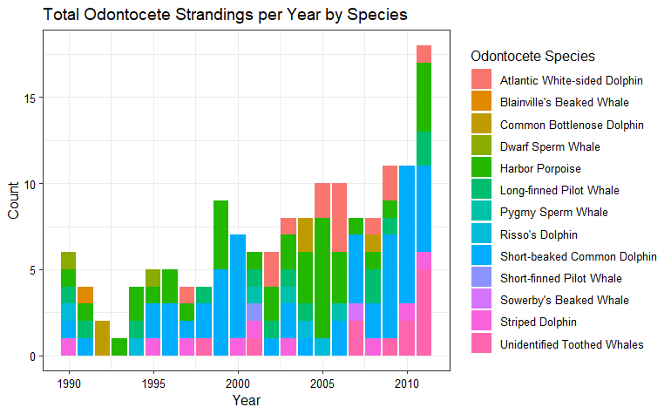
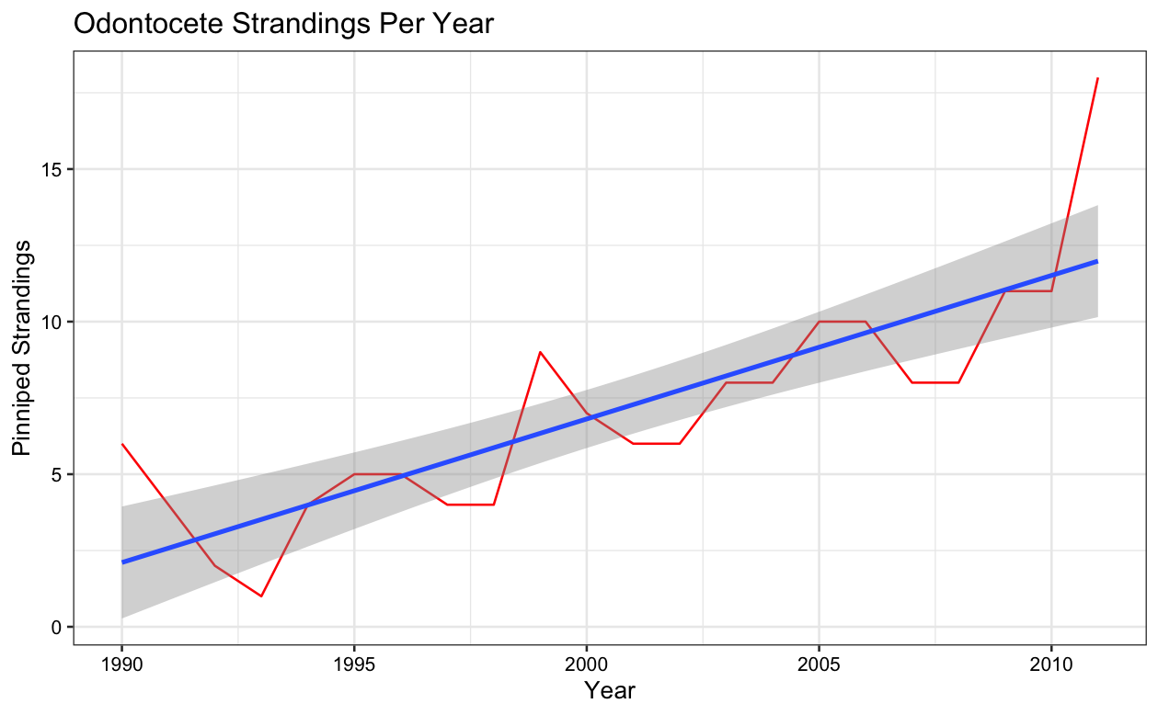
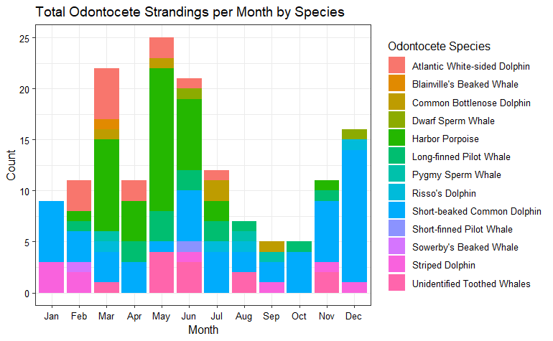

Slide 10
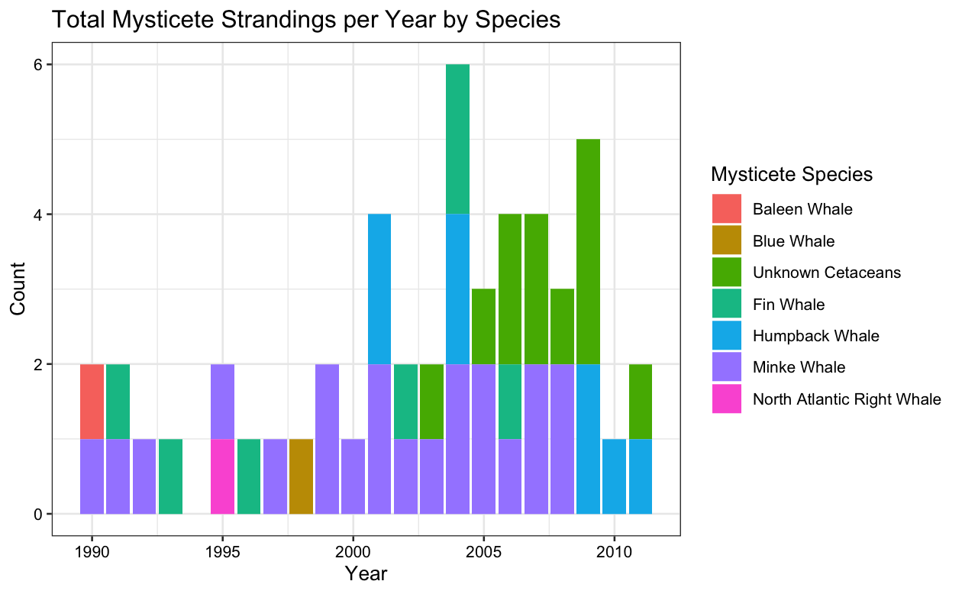
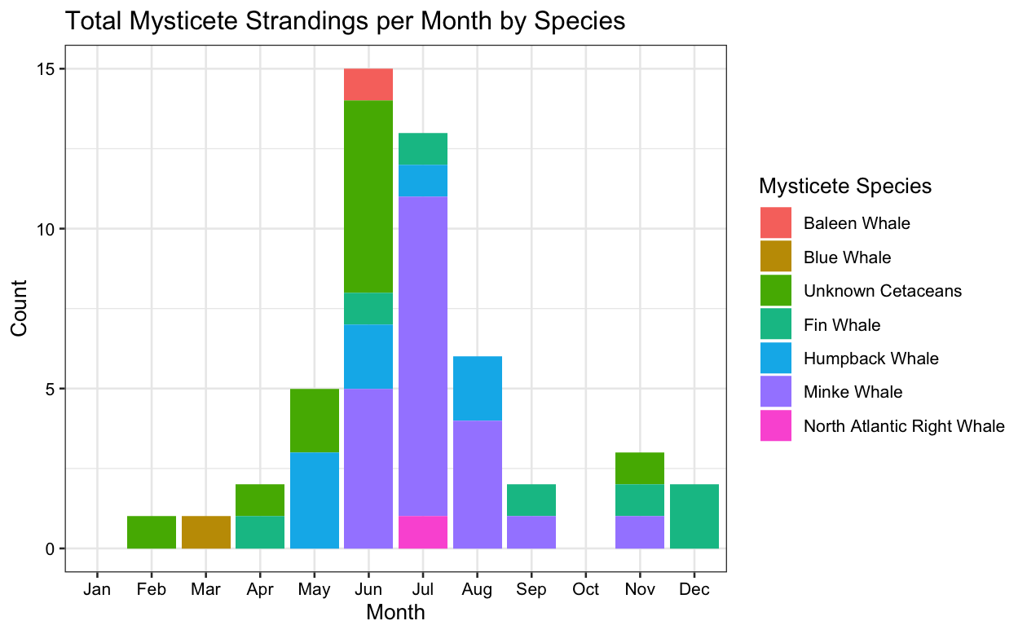

Slide 11
Results
Pinnipeds
Years and months are statistically significant for number of strandings
“Mean” stranding area (and distances from) determined
Yearly increasing trend in strandings
Possible seasonality – pupping season?
Turtles
Mysticetes
Odontocetes

Slide 12
Summary
Knowing that years and months are statically different for strandings opens to door for future analyses as to why these differences exist.
Knowing why can allow for prediction and/or prevention
Knowing time trends and geospatial locations allows for better allocation of resources for stranding response.

